Slide 1


Brexit
Supports for Business
Thomas McEvoy
Head of Enterprise
Louth Co.Co.
30th Sept 2020
LocalEnterprise.ie
#MakingItHappen

Slide 2














LEO Louth – First Stop Shop
Louth County Enterprise Fund
LocalEnterprise.ie
#MakingItHappen

Slide 3
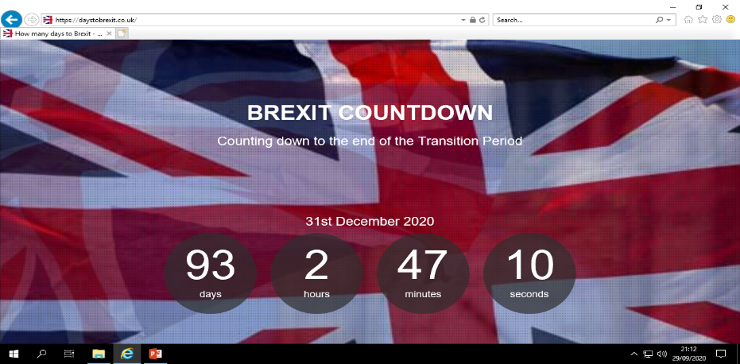
End of Transition Period (as at Tues, 29thSept)

Slide 4
Brexit: UK – EU Negotiations
Best possible trade negotiation outcome for Ireland would be an agreement that has an acceptable balance of rights and obligations for all parties and with the following main elements:
No tariffs
Large quotas for agricultural products
Low border costs
Landbridge transit /flow
Low regulatory divergence
Low barriers for service trade

Slide 5

Brexit – top of Ireland’s
Enterprise agenda
Most significant economic challenge of
past 40 years
Huge challenge for Irish companies
  UK is largest market for Indigenous business
  (€7.5bn / 37% of indigenous exports / 15% of all exports)
  UK is often first export market, particularly NI
Implications for all sectors, particularly food related
Encouraging SMEs to prepare for Brexit and mobilise now
Objective: Strengthen business to deal with any kind of Brexit

Slide 6
Nine areas of exposure
Businesses need to consider……..
Slowdown in UK market – possible market contraction and price pressures
Currency – impact on profits; delayed decision making due to uncertainty
Customers – Brexit will also impact customers of Irish businesses /exporters
Competition – expect new and increased competition
Supply chain – impact on cost, certainty and quality
Transport and logistics – established transport routes may no longer be optimal
Regulations and standards – may change for exporting to & importing from UK
Customs, tariffs and taxation – may see increase in administration, cost, time
Movement of people – possible restrictions (other EU nationals)

Slide 7

Business Supports Roadmap
– 3 steps to mitigate Brexit
1. Assess Exposure – LEO Brexit Advisory Clinic / LEO Brexit Mentor / BREXIT Scorecard
2. Prepare a Plan
- Avail of Advise; and Grants from Enterprise Ireland and InterTradeIreland
3. Get Supports (financial and non-financial):
- Build Competitiveness
- Expanding reach/ Target New Markets
- Innovation
- Building Scale / Finance
- Advice (mentoring/ *Customs training in Sept, Oct and Nov)

Slide 8
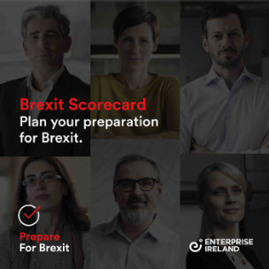
Step 1: Assess Exposure to BREXIT
LEO Brexit Advisory Clinic / LEO Brexit Mentor / Brexit Scorecard
T: 1890 202 303 or E: info@leo.louthcoco.ie Ref. LEO Louth Brexit Mentor
Go online:
www.PrepareForBrexit.com
www.gov.ie/Brexit
Free online tool to self-assess readiness for Brexit in key areas:
  Strategy, Operations, Finance, Sales/ Marketing, Innovation, and People/Management
Leads to LEO /EI supports package

Slide 9

Step 2: Avail of Advise &
Supports to Prepare a Plan
‘Prepare a Plan’ Grants:
- Enterprise Ireland clients
(€5,000 to prepare Brexit Plan)
- Non-Enterprise Ireland clients
(€2,250 InterTradeIreland Brexit Ready Voucher)

Slide 10
Step 2: Avail of Advice
Tailored ‘Brexit’ Mentoring (via LEO)
Management Development/ Business Training
Customs Insight Course
Go onto LEO / EI website
View Course and/or Register to participate
Export Development Workshops

Slide 11


Step 3: Get Supports to Build Margin
Four strategic responses
Development of better solutions (new or improved products services or processes) to provide a strong competitive edge
= Co-Innovate /
Innovate Accel./
Agile Fund
Optimising people, equipment, technology, and information in sourcing, production and delivery of goods and services
= LEAN Prog
Competitiveness
Innovation
and R&D
Diversifying into new international markets and new market segments within the UK and elsewhere
= Export Grant
Strong operational finance in parallel with strategic financial planning
= Brexit loan scheme
Expanding Reach
Financial Management

Slide 12

Competitiveness:
LEAN Programme
Across all sectors
Strong focus - LEO 2020
Subsidised Cost (+90%)
Most effective programme open
Produces Results!

Slide 13

Innovation:
1. Co-Innovate Programme
    Manufact’g & tradable services with international potential
  SMEs in Border Counties & NI (contact: LEOs/LEAs) - Free
Innovate Accelerate Europe
Supplementary support for Louth cos. (<10 employees) / target New Markets
3. Innovation Vouchers (€5k value research at 3rd level inst.)
4. Agile Innovation Fund (R&D costs, over 18mts, up to 45%)

Slide 14


Reaching New Markets
Export Grant
  Businesses employing up to 10 FTEs
  50% of costs met, up to €2.5k grant
  Explore and Develop New Export Markets
  Manufacturing/I.T.S.; Eg. participation at trade fairs, international trade networking events, marketing materials, translation, export websites
  Application forms available from LEO

Slide 15


Financial supports
MFI (all sectors, non-secured loans <€25k, via LEO)
SBCI (Brexit loans >€25k <€1.5m, via pillar banks)
LEO Grant supports (Manufacturing/I.T.S.)
Trading Online Voucher Scheme (training, support and 90% grant up to €2.5k, all sectors, via LEO)

Slide 16

Border Region Stimulus Package
Four New Funds
€3m for the LEOs (in partnership with Enterprise Ireland) for capability development programmes for micro and small enterprises
€8.5m for an EI Brexit Transformation Fund to assist client companies transform their businesses and diversify markets
€15m for a competitive Border Enterprise Development Fund to build enterprise capability and resilience. Administered by Enterprise Ireland on behalf of the Department of Business, Enterprise and Innovation
€1.5m for Science Foundation Ireland Fellowship Programme placing research and innovation capability in businesses across the 6 counties
Budget allocation:
€28m Stimulus Package for four new initiatives
Purpose of Fund:
Mitigating the impact of Brexit and other market challenges in the Border Region
Aim:
Strengthening existing initiatives to build increased capability / resilience
Response to the recommendations of the OECD’s review on Irish SMEs
Initiative | Allocation | Lead
LEO capability development programmes | €3m | LEO and EI
EI Brexit Transformation Fund | €8.5m | EI
Border Enterprise Development Fund | €15m | EI on behalf of DBEI
Industry Fellowship Programme | €1.5m | SFI

Slide 17


Thank you
Local Enterprise Office,
Louth County Council
Town Hall, Dundalk
T: 1890 202 303 E: info@leo.louthcoco.ie
W: www.localenterprise.ie/Louth www.prepareforbrexit.com www.gov.ie/Brexit

