Slide 1


Crowdfunding
Rowena Neville
Director of Marketing, Business to Arts | Fund it
@rowenaneville | @businesstoarts | @fund_it
Notes:
http://vimeo.com/78344447

Slide 2
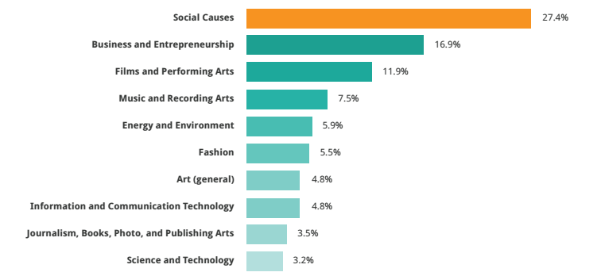
Active Categories – All Platforms
Source: 2013 Crowdfunding Industry Report (2014) masssolution.com

Slide 3
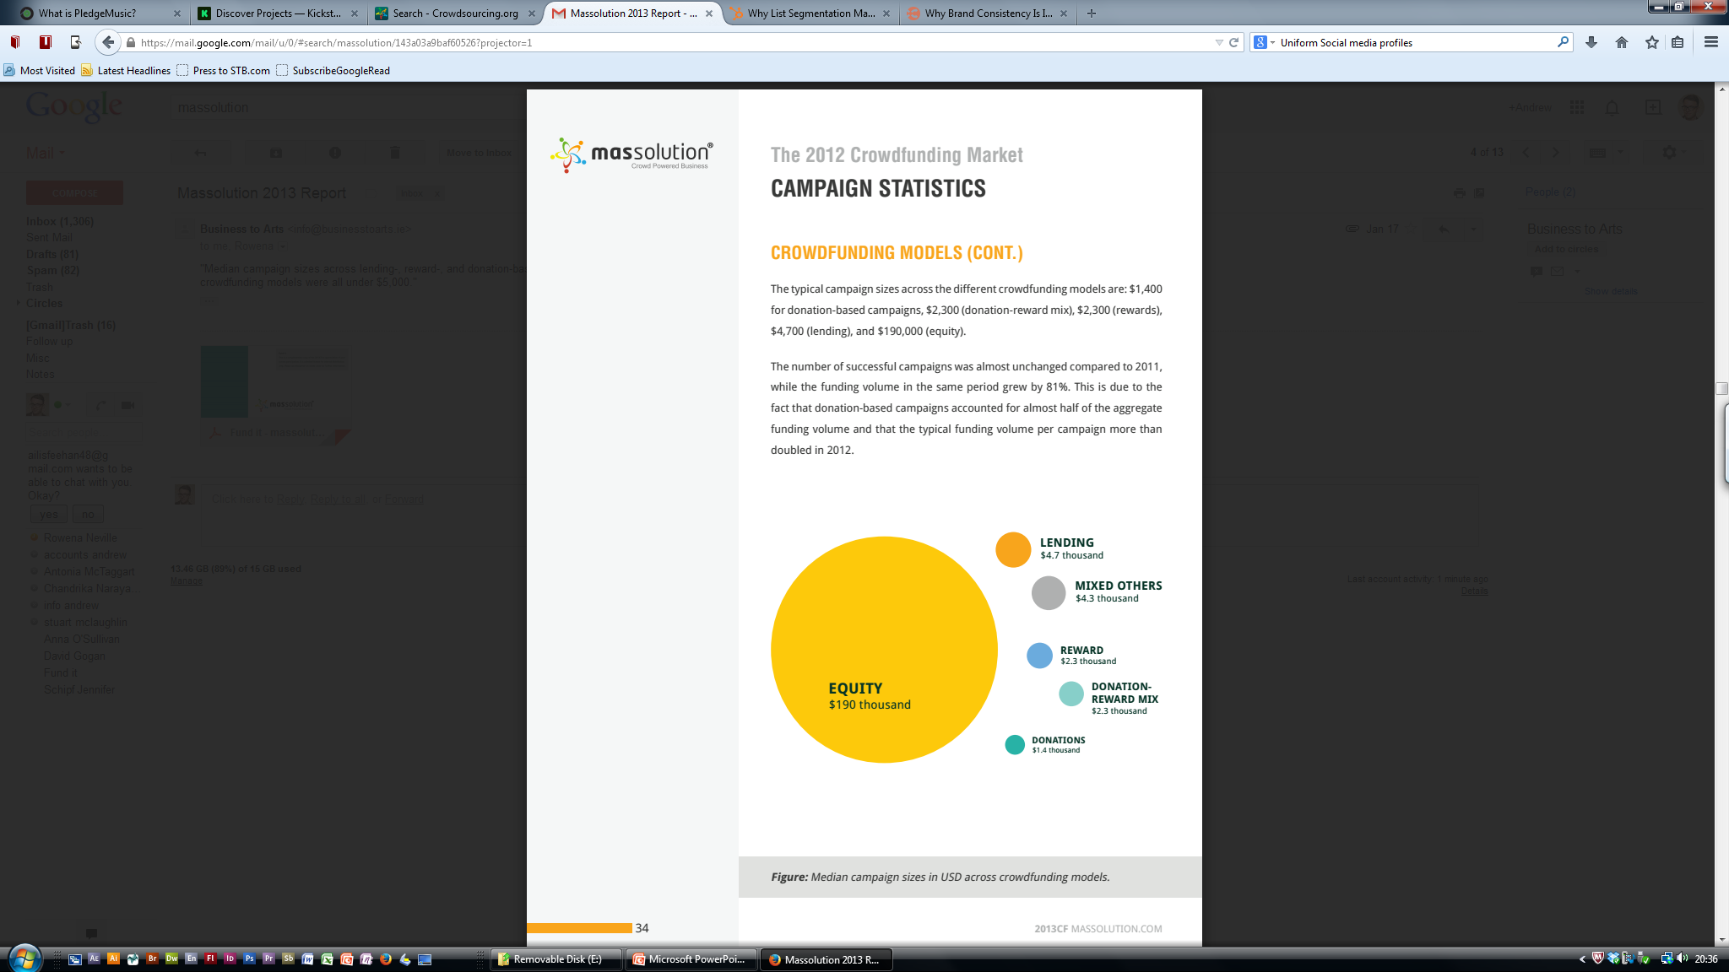
Active Categories – All Platforms
Source: 2013 Crowdfunding Industry Report (2014) masssolution.com
Across all crowdfunding sites the median successful project value is less than $5,000

Slide 4
Common Platforms – Irish Creators
Site | Fund it | Indiegogo | Kickstarter | Pledge Music*
 | All or nothing | Flexible & All or nothing | All or nothing | All or nothing
Success rate | 73% | 34%* | 43% | 90%
Charges | 8% | 9-14%* | 8-9%* | 15%
Examples | Sheep Watch | Invizibox | The Pip: A Biosensor
Notes:
https://www.indiegogo.com/explore?utf8=%E2%9C%93&filter_city=&filter_country=CTRY_IE&filter_quick=popular_all&filter_title=&filter_category=Music&fetch_count=12&scroll_top=380&commit=Submit&filter_percent_funded=&filter_status=&filter_funding=
https://www.kickstarter.com/discover/advanced?category_id=14&woe_id=23424803&sort=most_funded

Slide 5

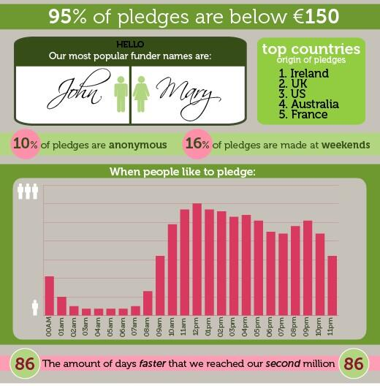
Music on Fund it
Vital Statistics* | Total
Successful Projects | 722
Amount Pledged | €3,006,399
Average Project | €3,841.00
Average Funders | 68
Average Pledge | €56.22
Average Duration | 35 days
Max Project Value | €32,079*
Fund it Blog http://www.fundit.ie/info/blog
Fund it Frequently Asked Questions http://www.fundit.ie/info/faq/
Crowdfunding Advice http://www.fundit.ie/info/category/crowdfunding-advice/
Case Studies http://www.fundit.ie/info/category/case-studies/

Slide 6
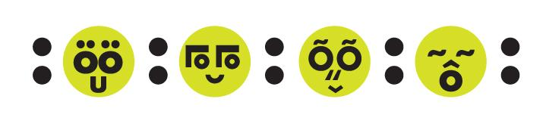
What can be crowdfunded?
Projects must be just that. They must have a clear beginning and an end. They cannot be on-going causes or charities (although there’s no reason why a charity cannot have a creative project they would like to propose).
Projects must not be related to funding lifestyles or funding businesses. If your project ends up creating wealth, this is OK, but they must not be for supporting on-going expenses.
Projects must not cause unnecessary offence to any particular section(s) of the community.
Technology-related projects are great, but not ones where the technology development is sub-contracted. Developers, eat your heart out!
You must be over 18 years of age.
Notes:
“Non-profit organisations show up strongly as the primary driver of success [with crowdfunding] while other variables are never significant.” Lambert, T & Schwienbacher A (2010)

Slide 7
Phase 1 - Preparation
Be prepared for work before, during & after campaign
Your budget needs to stand up to questioning
Create a quality submission
Your rewards should be as creative & desirable
Talk to successful projects creators
Create a list of 50 social influencers in your network
Deliver your project & rewards before attempting next campaign
Prepare to accept feedback before, during & after your campaign
Read: http://fundit.ie/info/the-seven-deadly-sins-to-avoid-when-submitting-a-project/
Notes:
“Non-profit organisations show up strongly as the primary driver of success [with crowdfunding] while other variables are never significant.” Lambert, T & Schwienbacher A (2010)

Slide 8
Phase 1 - Preparation
Analysis of Personal/Group Network
Creation/Analysis
Monitor delivery/bounce rates and correct
Assess ways to improve delivery rates
Consolidation
Email providers (eg. Gmail, Outlook)
Group/band members* Importance of comms consistency
Consider email marketing solutions (eg. Mailchimp)
Segmentation
Not all funders are the same
Your audience are at different points in crowdfunding ‘cycle’
Reputation and success improves with targeted emails
Notes:
“Non-profit organisations show up strongly as the primary driver of success [with crowdfunding] while other variables are never significant.” Lambert, T & Schwienbacher A (2010)

Slide 9
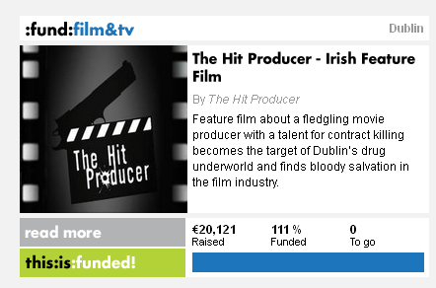
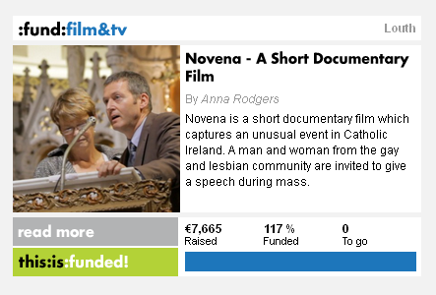
Phase 2 - Preparation
PREPARATION – VIDEO
A crowdfunding video creates credibility around the project
Usually consists of the creator speaking about the project
Usually slightly longer than commercials and tutorials
Audience more engaged with the project & looking to learn more
Video can be preferable to text content
Notes:
75% Success Rate

Slide 10
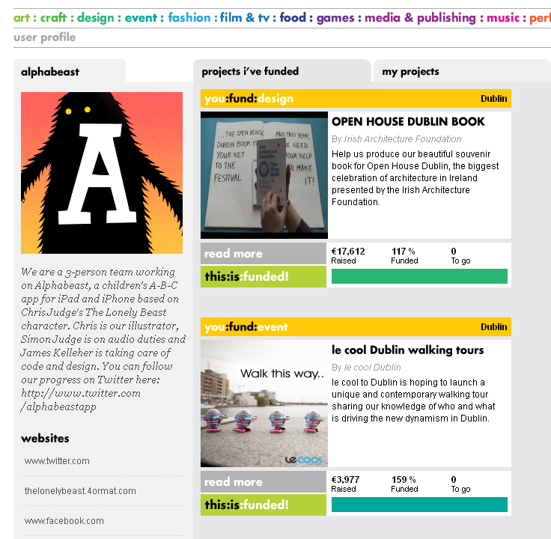
PREPARATION – USER PROFILE
Image (square & less than 1MB)
Biography (less than 250 words)
Show interest in other projects
Fund/follow/spread/ get great rewards
Social Media Links
Where can people find out more information about you/project/organisation?
Research... start with our BLOG
http://www.fundit.ie/info/category/crowdfunding-advice/
Notes:
75% Success Rate

Slide 11

PREPARATION – IMAGE, TITLE & SHORT DESCRIPTION
IMAGE | TITLE | SHORT DESCRIPTION
Square Less than 1 MB Related to Project | Decide on this in advance Concise & Relevant Max 40 characters | Max 180 characters Elevator Pitch / What are you asking the reader to do?
Notes:
75% Success Rate

Slide 12
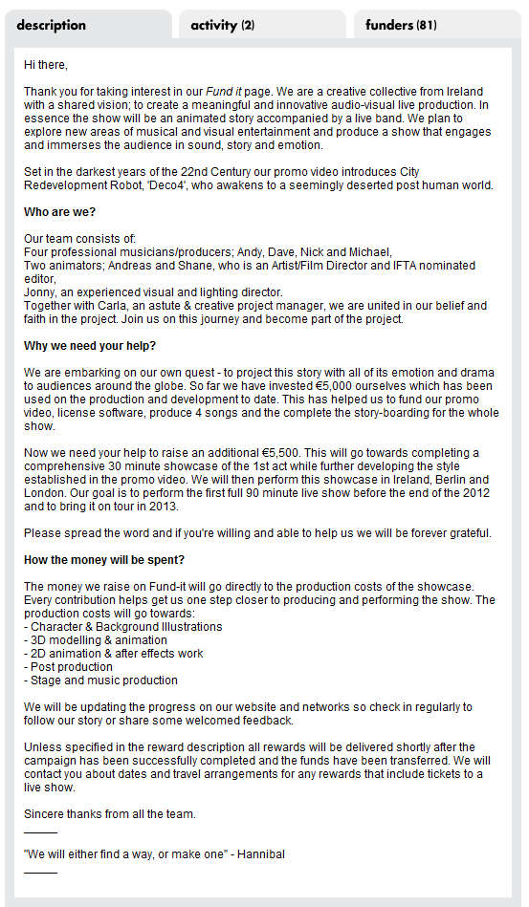
PREPARATION – MAIN DESCRIPTION
Word Count
NB: TRANSPARENT & PERSONAL
What is the project?
Who is involved?
What is their experience?
Why are they using Fund it?
What is the budget for the project?
How much do you need to crowdfund?
What will the money be spent on?
Thank people
Notes:
75% Success Rate

Slide 13
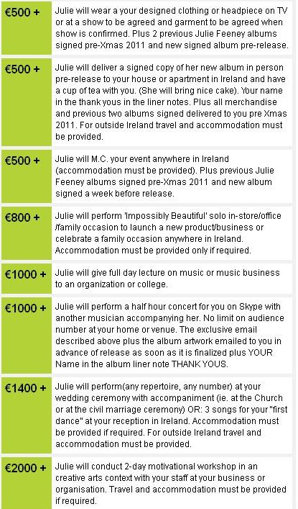
PREPARATION – REWARDS
Test rewards with your audience
Make rewards creative and unique
Relate rewards to project, people or organisation
Variety of price levels – NB €50 level
High crowdfunding target =
High value rewards are VERY important
Budget for appropriate delivery
Limit amount of rewards available where necessary
Notes:
75% Success Rate

Slide 14










Mass Emails
Personal & Organisational
Launch (General)
Throughout (Targeted)
Midway (General)
Prior to End (General Update)
Phase 3 -
Running the Campaign
Social
Consistency: Profile, Links, Images
Project Videos/Media
Interactive/Personalise/Thank You
Competitions
Activity updates
Other Media
Targeted
Informative
National & International

Slide 15
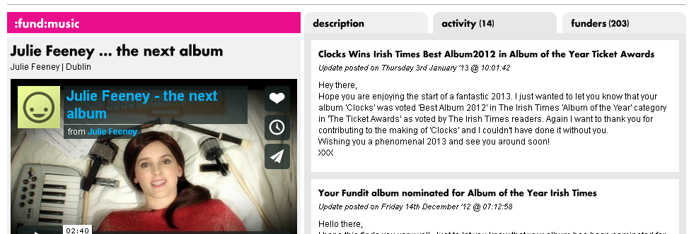
Phase 4 – Completion
Create a calendar for communications (eg. monthly)
Divide your funders into manageable lists (eg. reward type)
Respect privacy and use bcc field
For large lists use appropriate email marketing solution (eg. mailchimp)
Use the ‘Activity Update’ section of crowdfunding website too
Allocate a primary contact for funders (eg. full time employee of company)
Maintain communications after reward delivery
Notes:
75% Success Rate

Slide 16
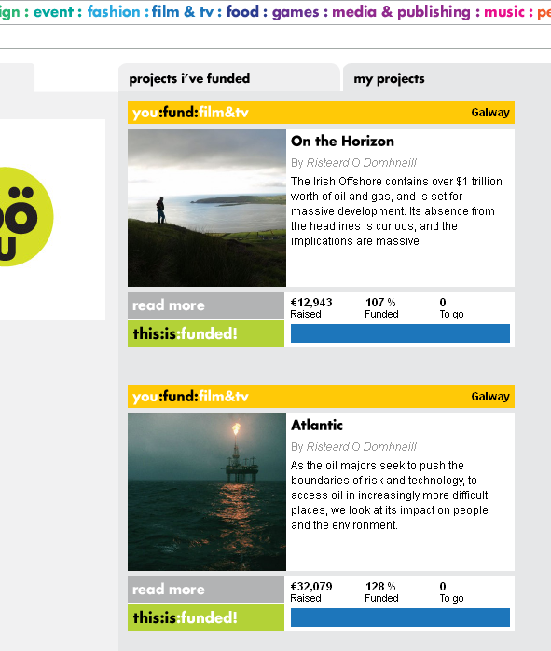
Phase 4 - Running Your Second Campaign
What did you learn from your first campaign? (eg. timing, rewards, delivery)
Have you maintained regular communications with your funders?
Have you (over)delivered your rewards?
Have you socialised the idea with your network/previous funders?
What’s new different about your process this time?
Notes:
75% Success Rate

