Slide 1

LINKED FINANCE.COM
Irelands only
‘Crowd Funding’ lending platform for SMEs.
Linked Finance VIDEO
*A NEW alternative for business lending in Ireland

Slide 2

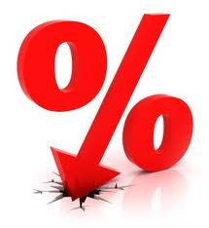

Why ‘SME’ Crowd Funding
Banks not lending to the 189,000 Irish SMEs
€92 Billion in private individuals/households
savings earning ‘low’ interest rates.
Therefore these is an opportunity to help
solve both these problems by ‘crowd funding’
LINKED
FINANCE.COM

Slide 3


Who are Linked Finance
Enterprise Ireland HPSU 2012
Chairman - Kingsley Aikins
Founders - Peter O’Mahony, Conor McAleese,
Marc Rafferty
Advisors - Enterprise Ireland,
Senator Feargal Quinn , PWc.
LINKED
FINANCE.COM

Slide 4
So FAR……
145 SME loans fulfilled
Average loan €28K
Over 7000 Registered Lenders(Average 247 lenders per loan)
Average % rate 8.7% - unsecured lending
No defaults (target rate 1.5%)
LINKED
FINANCE.COM

Slide 5
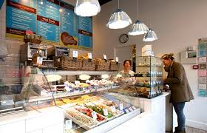
CASE STUDIES - https://linkedfinance.wordpress.com
Lolly & Cooks – opening new location

Slide 6
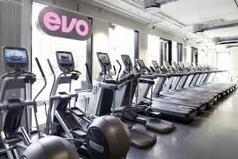
CASE STUDIES - https://linkedfinance.wordpress.com
Evo Fitness – New Gym equipment and Staff & Marketing!
LINKED
FINANCE.COM

Slide 7

CASE STUDIES - https://linkedfinance.wordpress.com
GreenAer Bikes – Finance for Stock and new website video
LINKED
FINANCE.COM

Slide 8


A Truely Social Network
Example: Your business has:
200 LinkedIn connections
500 facebook friends
300 twitter followers
Required: €25,000 loan
*If 250 of your connections make a €100 contribution, the loan would be fully funded. Even without the Linked Finance existing network of lenders.!!!!!
LINKED
FINANCE.COM

Slide 9


We are emulating successful models
United Kingdom
www.fundingcircle.com
£300 million plus in business loans since launch in late 2010
Recent received £20 million from the British Government to lend to businesses on their site
United States
www.kickstarter.com
Over $450 million pledged to business projects since April 2009
Over 3 million lenders
NOTE:: Lending club – GOOGLE as major Shareholder!!
LINKED
FINANCE.COM

Slide 10
3 year PLAN!
€200M in SME lending to over 5000 SMEs
Different finance products and terms
10,000 Jobs
Institutional money
Pension money (Self Administered)
Competition is good - Cofunder and Your Money
2014 Oireachtas Report on Jobs and Innovation: Recommendations:
Government institution invest 20% in each loan.
Tax Incentive for first €10K in interest gain for lenders.
LINKED
FINANCE.COM

Slide 11
Next Step
REGISTER
ON
LINKEDFINANCE.COM
Promo Code: WoodQuay
LINKED
FINANCE.COM

