Slide 1

Finance4Growth
1-9-14
Dr. Lorcán Ó hÓbáin
Niamh Desmond

Slide 2

“A programme designed to help business owners to improve their capabilities in presenting their business case when seeking to raise finance for their firm.”

Slide 3

Confidence
“We were very happy with the session. We got into a lot of detail and he could answer all our specific questions, I’d delighted we went along.”
Sinead, Retailer

Slide 4
Confidence
“...I was in the process of applying for funding and was struggling to get the application to completion stage. Niamh’s help and the mentor I was assigned were crucial to me submitting an application that met with the criteria required. It was an extremely valuable learning process, the mentor was extremely dedicated and committed, exceeded my expectations and certainly went the extra mile in assisting me with the application”.
Noreen, Hibernia Study Abroad

Slide 5
“Established small to medium companies who want to raise finance to grow their business”

Slide 6
Finance4Growth
Free 2 hour mentoring session (without commitment)
Option to commit to programme balance
  1 full workshop based day
  1 x 2 hour mentoring session follow-up
  Fee of € 200 plus VAT

Slide 7
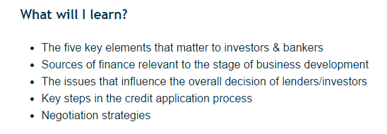

Slide 8

To Access – log onto www.managementworks.ie

Slide 9
