Slide 1
What we offer in the M1 Corridor?
An Overview: Talent, Infrastructure, Connectivity, Start Up Ecosystem and a proven Track Record.

Slide 2
Invest Here, Expand Anywhere
The M1 Corridor offers businesses unrivalled access to highly skilled talent & infrastructure and offers employees coastal and uncongested urban living for a superb work life balance.
Catchment Population
60 min
2,247,000

Slide 3
An initiative of
Louth County Council, Louth LEO, Dundalk Chamber, Drogheda & District Chamber, The Mill Enterprise Hub & Oriel Hub

Slide 4
Background
Government Policy

Slide 5
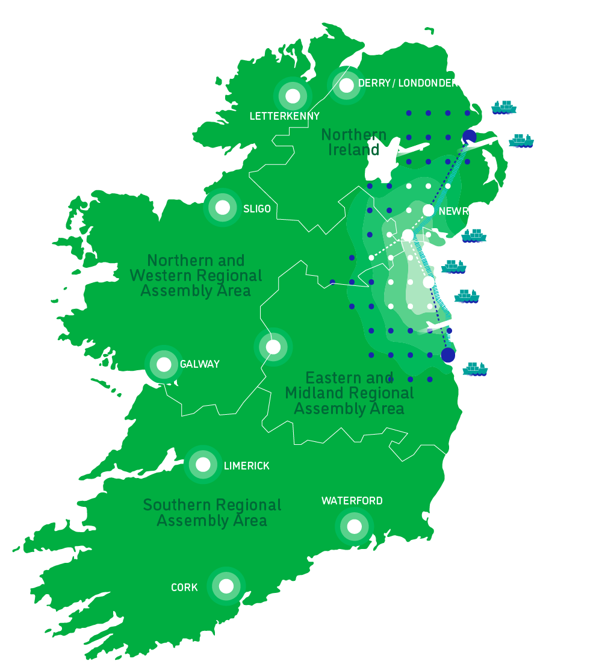
Strategic Location
The heart of the Dublin-Belfast Economic Corridor
The M1 Corridor is at the centre of economic activity in Ireland. As the only English speaking country in the EU & Eurozone, Ireland is ideally positioned to provide an international hub for businesses seeking a European base.
The M1 Corridor is strategically located at the heart of Ireland’s Dublin-Belfast Economic Corridor (DBEC), making our region an ideal base for companies looking to access both the EU and UK marketplaces.

Slide 6
Government Policy
Led to establishment of M1 Corridor
Project Ireland 2040 - National Planning Framework
One of the key National Policy Objectives - Objective 2b: Building Stronger Regions, Accessible Centres of Scale.
Addresses the key future planning, development and place-making policy priorities for the Eastern and Midland Region.
Focused approach to compact, sequential and sustainable development of the larger urban areas along the Dublin – Belfast economic and transport corridor.
Discussion at SPC (Economic Development and Enterprise Support) and Louth Economic Forum.
Led to establishment of working group, made up of Chambers of Commerce in Co Louth with other economic stakeholders (Oriel Hub, The Mill) with LEO/LCC.

Slide 7
Introducing the M1 Corridor brand
A single ‘Louth centric’ marketing product

Slide 8
Objectives
Leverage employment opportunities, skillsets in the region, aid future sustainable population growth.
Provide substantiated key facts and figures that demonstrate the region as an ideal location to start or grow a business.
Enhance the profile of the Region/M1 Corridor as a location recognised as an excellent opportunity for trade and investment.
Working Group
Louth Economic Forum’s agreed action to develop marketing collateral to promote Dundalk/Drogheda/all county as a single product, rather than as individual towns.

Slide 9
Methodologies
Offline / Online / Video Marketing
Identifying location solutions for investors
Sources of Data: Commissioned Spatial Insights (AIRO) to map Dundalk/Drogheda data
- defined catchments (15/30/45/60mins)
- key socio-economic data on region
- skills availability and skills mobility

Slide 10
Brand Purpose & Vision
Our Purpose
Our purpose is to showcase M1 Corridor as an ideal place to live and work and as a ‘Region of Innovation’ to a global audience so that we continue to attract inward investment that boosts high quality employment.
Our Vision
To become the most attractive inward investment region in Ireland outside of the capital.
Our Guiding Principles
Regional / Not associated with any single town
Potential to be recognised internationally
Future looking, connected,
Louth at its centre, but not exclusively Louth
Aligned to National Planning Framework / Project Ireland 2040 and RSES
(Drogheda-Dundalk-Newry cross border axis as a regional growth centre)

Slide 11
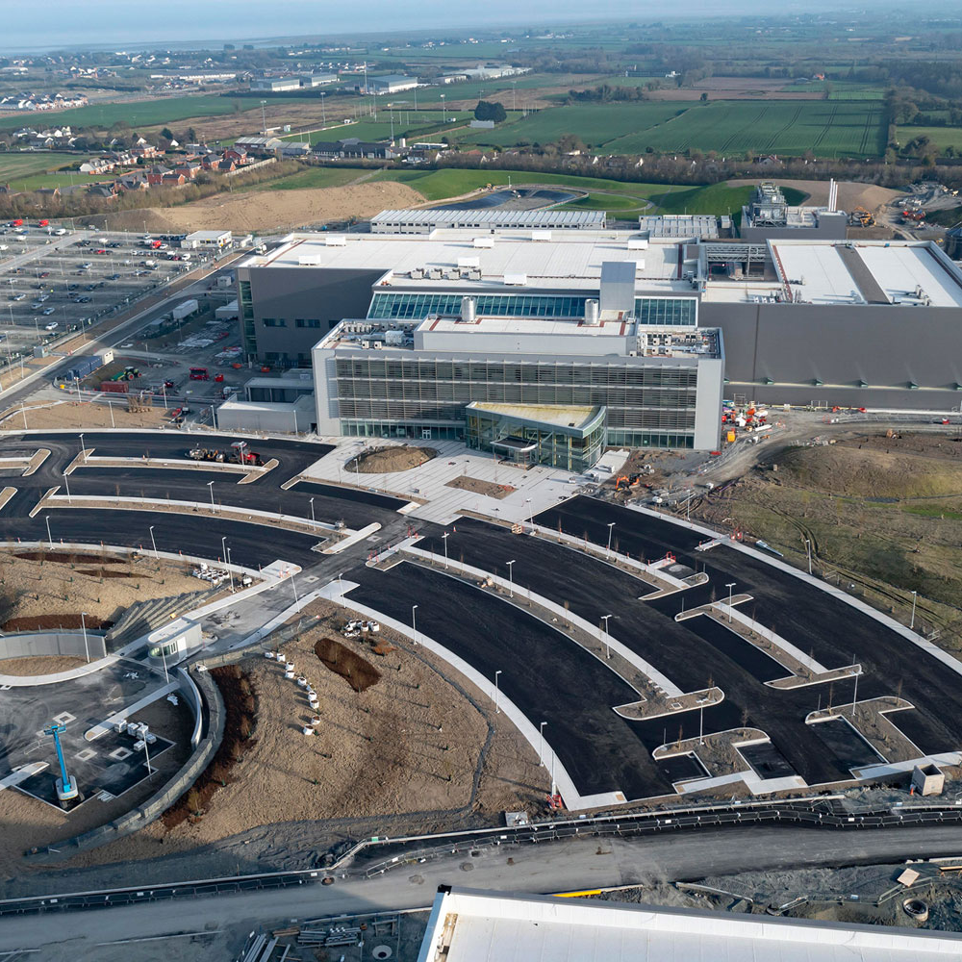
Target Audience #1
Potential Employers / Investors
New FDI considering investing in Ireland, particularly those requiring international connectivity, supporting IDA Ireland’s Regional Strategy;
existing FDI stock in Ireland seeking a second site /expansion and consider Dublin prohibitive;
indigenous industry seeking a second location;
building clusters of expertise in the energy, agri-food, research and FinTech/ payments industries;
supportive location for High Potential Start Up companies

Slide 12
Target Audience #2
Potential Employees
Win the war on Talent
Locate development where people can be at their best
Coastal Living
Uncongested commutes
Work / Life Balance
Vibrant urban Centres

Slide 13
What drives Business Investment Decisions?
Government Policy

Slide 14
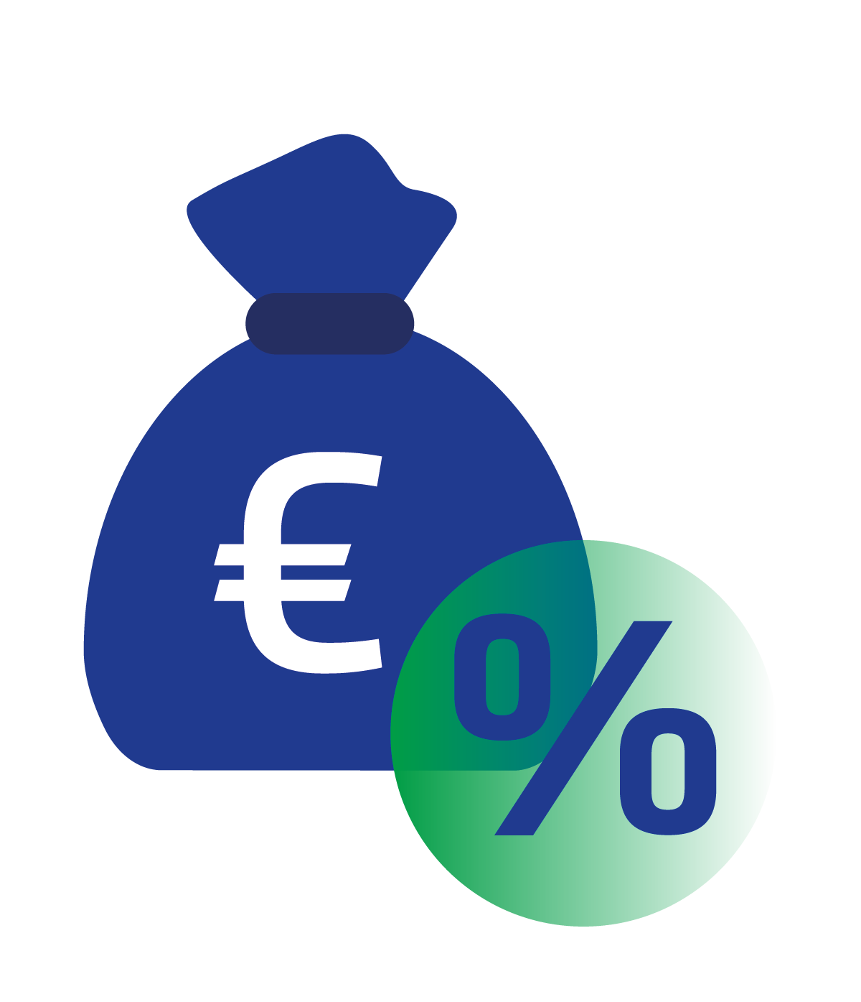
Drivers of Investment
TALENT
Critical mass of population/ profile of population
TRACK RECORD
Peer companies encourage others to invest/ cluster effect
TECHNOLOGY
Teleco/broadband infrastructure/specialist skills
CONNECTIVITY
Links to international ports and markets
PROPERTY SOLUTIONS
Availability of modern ‘turnkey’ properties (suitable buildings, locations, legally clean, technical standards) – in an urban/city type setting.
ACCELERATOR /VC FUNDS /MARKETS
Access (for indigenous companies
COMPETITIVENESS & COSTS
Labour / Property
EDUCATION / SKILLS
Access to research and third level
ATTRACTIVE LOCATION
offering quality lifestyle to employees/families eg. restaurants, schools, public realm, footfall, etc..
ROI FACTORS
EU / EURO / TAX

Slide 15
Our 6 Core Pillars
TALENT
Dense population of young, highly skilled and mobile workforce.
CONNECTIVITY
Links to international ports and markets
INFRASTRUCTURE
Developed and zoned property solutions with enviable broadband speeds.
TRACK RECORD
Proven success with many businesses across multiple industries
START UP ECOSYSTEM
A flourishing start up scene and developed economic clusters
LIFESTYLE
Uncongested coastal living in vibrant urban spaces

Slide 16
1. Talent

Slide 17
Catchment Profile
Dense Population

Slide 18
The Talent is here
The M1 corridor provides a young and highly educated workforce, in Ireland’s most densely populated region outside Dublin.
2.25m
population in just 10% of land mass. Projected 2.61m by 2031.
50%
Almost half of the population of the Republic of Ireland reside here.
1 in 3
of the population is under 25 years old.

Slide 19
12
Higher Education Institutions with 58% of all university enrolments.
86,000
= combined full time student population
40%
of all third level graduates are here
46%
of Ireland’s STEM graduates are here.

Slide 20
250,000
Non Nationals live here.
= 47% of foreign language speakers in Ireland.
600
International students in DKIT. Strong connections to China, with office in Beijing.
61%
Of outbound commuters are highly skilled (hold third level degrees)
270,000
of workforce have apprenticeship and trade qualifications

Slide 21
Education Facilities
Dynamic educational institutions supporting industry needs with skilled talent and collaborative opportunities for solving problems

Slide 22
2. Connectivity

Slide 23
Greater Connectivity By Air
3 international airports within 75 minutes
20/40 minutes to Dublin Airport
250 destinations with direct flights.
300 weekly flights to London
13 North American destinations with pre-clearance.

Slide 24
Greater Connectivity By Sea
4 Deep sea ports within 60 minutes, Dublin, Greenore, Warrenpoint & Larne
50% of tonnage handled at Tier 1 Port Dublin
Drogheda Port of Regional Significance
Warrenpoint Trust Point

Slide 25
Greater Connectivity By Road & Rail
Intercity Service connecting Dublin and Belfast in 2 hours.
M1/A1 Motorway connecting Dublin & Belfast
30mins Commuter Service from Dublin IFSC to Drogheda
60mins Commuter Service from Dublin IFSC to Dundalk

Slide 26
3. Infrastructure

Slide 27
1 GB fibre broadband
Louth is Ireland’s fastest county!
86% of the region has access to 1 Gigabit high-speed fibre broadband

Slide 28
Infrastructure & Property
The M1 Corridor is investor ready with existing utilities and property.
300+ Office, Industrial & Greenfield Sites
25% of the cost of Dublin City rents
Utilities Wastewater & Energy are in place

Slide 29
4. Track Record

Slide 30
Industry Clusters
A long history of fostering dynamic Sectoral Clusters
FINANCIAL SERVICES
LIFE SCIENCES
DIGITAL TECHNOLOGIES
FOOD MANUFACTURING
ENERGY & ENVIRONMENT
ENGINEERING

Slide 31
5. Start Up Ecosystem

Slide 32
Start Up Supports
The M1 Corridor has a number of Incubation Hubs and supporting agencies ready to help you grow and scale your start up in the M1 Corridor region.

Slide 33
6. Lifestyle

Slide 34
What to expect when living here
Win the war on talent – Locate people where they can be at their best
LINKS
https://beachawards.ie/blue-flag/sites/
https://www.volunteerlouth.ie/
https://www.lmetb.ie/
https://liveinthenortheast.ie/
https://www.drogheda.ie/
https://lovedrogheda.ie/
https://www.indrogheda.com/
https://www.visitlouth.ie/explore-and-do/explore-louth/towns-and-villages-louth/dundalk.html
https://dundalktown.ie/

Slide 35
Amenities on your doorstep
The scenic beauty of coastal living and the great outdoors
LINKS
https://fishinginireland.info/
https://carlingfordadventure.com/
https://www.visitlouth.ie/explore-and-do/do/golf-louth.html
https://www.dundalkstadium.com/
GOLF
HORSE RACING

Slide 36
Culture & Arts in the area
Coastal living in a tradition of literature, culture, arts and music.
LINKS
https://www.createlouth.ie/
https://www.visitlouth.ie/whats-on/festivals/
https://www.antain.ie/
https://www.louthcraftmark.com/
https://www.droichead.com/
https://highlanes.ie/
FESTIVALS

Slide 37
Tourism & Heritage
Coastal living in a tradition of literature, culture, arts and music.
LINKS
https://www.ireland.com/en-us/destinations/experiences/irelands-ancient-east/
https://www.visitlouth.ie/
https://www.sealouth.ie/
https://heritageireland.ie/
https://www.discoverboynevalley.ie/
https://www.drogheda.ie/explore-and-do/do/tours-and-trails/boyne-valley-camino.html
https://carlingford.ie/
https://www.visitcarlingford.com/

Slide 38
Get in Touch
Drogheda & District Chamber, Broughton House, Dublin Road, Drogheda, Co. Louth. Phone: 041 983 3544
Dundalk Chamber, Partnership Court, Park Street, Townparks, Dundalk, Co. Louth Phone: 042 933 6343
Local Enterprise Offices, Louth County Council, Town hall, Dundalk, Co. Louth Phone: 042 933 6343
www.M1Corridor.ie
hello@M1Corridor.ie

